Slide 1



BizNGO – IC2 Chemical Ingredient Disclosure
Principles
December 2020

Slide 2
December 2019 Meeting
Successful stakeholder meeting in Cambridge, MA to initiate process for developing a set of Chemical Ingredient Disclosure Principles; followed 2019 BizNGO annual meeting
Participants:
  State & local representatives from CA, MA, MN, NY, OR, WA, SF, King County, OR Metro
  Companies, including RB, Google, GOJO, Clorox, Human Scale, Anderson, Seventh Generation, Milliken, & more
  NGOs, including Clean & Healthy NY, Breast Cancer Prevention, Women’s Voices for the Earth, Toxic-Free Future, Center for Environmental Health, NRDC, HPD, & more
Purpose: To initiate the development of a set of principles for ingredient disclosure to help inform future programs & policies to which a wide array of stakeholders can agree

Slide 3
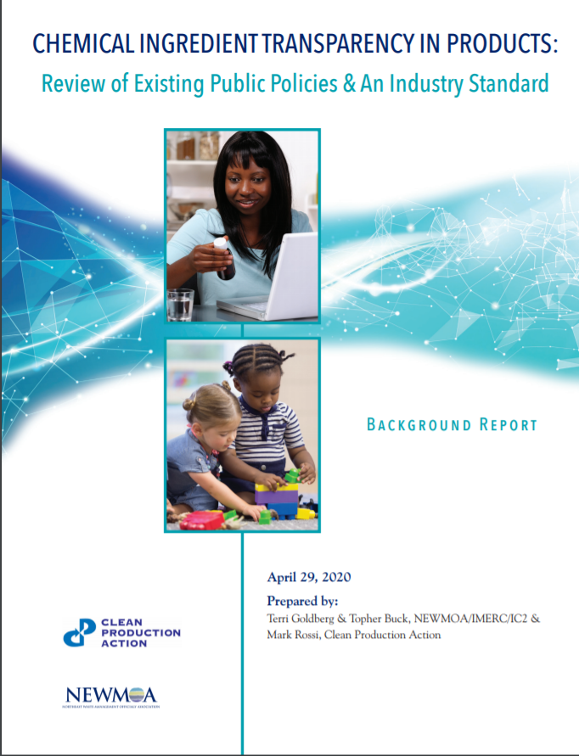
IC2 – CPA Report https://www.theic2.org/article/download-pdf/file_name/IC2-CPA_ChemicalDisclosure_ReviewPaper_FINAL.pdf

Slide 4
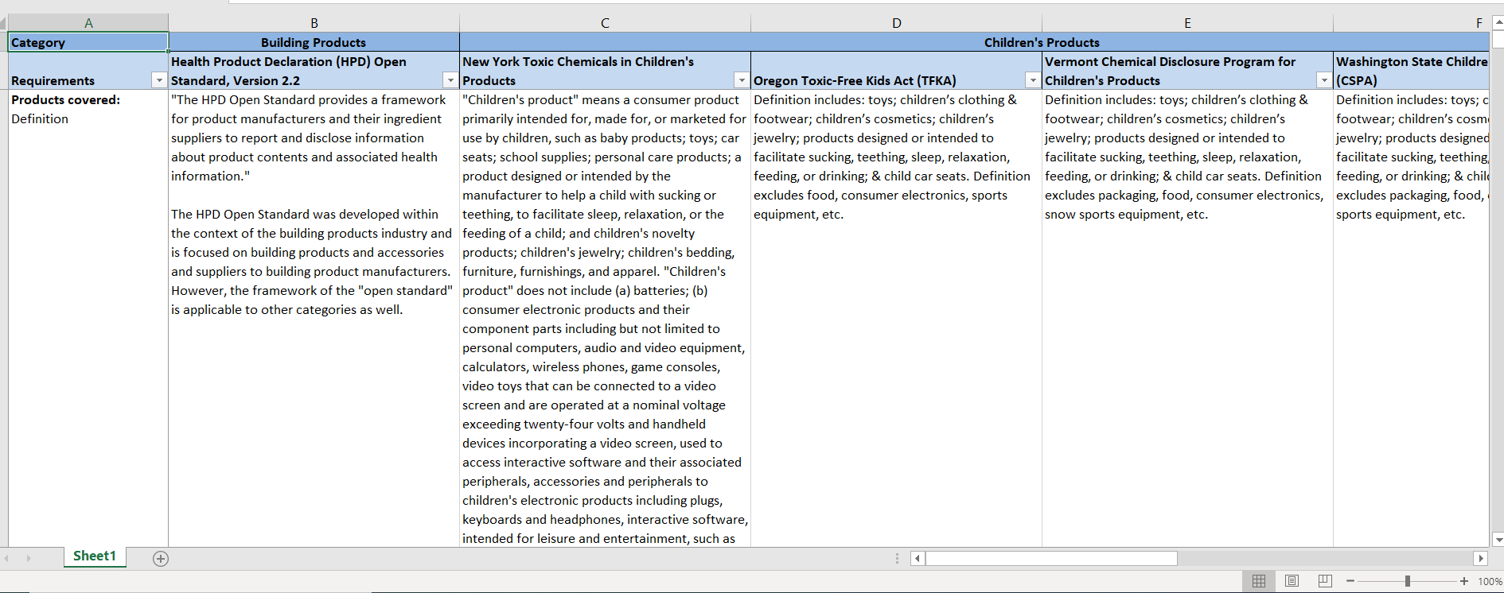
Spreadsheet
Download from https://www.theic2.org/publications

Slide 5
Developing Principles: Overall Questions
Aspirational?
How operational?
Definitions of key terms
Challenges with information flow/access within supply chains
Principles Plus Guidance

Slide 6
Key Issues Debated in Developing Principles
Reporting on intentionally added ingredients
Non-functional ingredients/incidental ingredients/contaminants
Criteria for specifying chemicals of concern for disclosure
Confidential business information (CBI)
Data gaps & need for improved/complete hazard information

Slide 7
Reporting on Intentionally Added Ingredients
Thresholds for disclosure of intentionally added ingredients or none?
Hazard characteristics?
The children’s product requirements set the limits disclosure of intentionally added ingredients as the practical quantification limit (PQL)
The HPD Open Standard allows companies to report to different threshold levels, including 100 ppm & 1,000 ppm
“Disclose all intentionally added chemical ingredients. Disclosure comprises identity of the chemical ingredient, including name(s), CAS registry number, function, presence on specified lists of chemicals of concern, & other chemical hazard characteristics of the ingredient.”

Slide 8
Definition of Intentionally Added Ingredient
“a chemical that a manufacturer has intentionally added to a designated product & that has a functional or technical effect in the designated product, including, but not limited to, the components of intentionally added fragrance ingredients & colorants & intentional breakdown products of an added chemical that also have a functional or technical effect in the designated product” (Source: State of California, Senate Bill No. 258, Cleaning Product Right to Know Act, October 15, 2017)

Slide 9
Non-functional Ingredients
Significant debate on the definition
“Nonfunctional constituent: a chemical that has no functional or technical effect on the designated product & is present as an incidental component of an intentionally added ingredient, a breakdown product of an intentionally added ingredient, or a byproduct of the manufacturing process.”
“Incidental component:
(1) a chemical which was added during the manufacturing process at any point in a product, a raw material, or an ingredient’s supply chain, but which has no functional or technical effect in the finished product, including an unreacted chemical; or
(2) a chemical present in the environment as a contaminant which was introduced into a product, a raw material, or a product ingredient at any point in the supply chain for the product, raw material, or ingredient, as a result of the use of an environmental medium, such as a naturally occurring mineral, air, soil, or water, in the manufacturing process.”

Slide 10
Specifying Chemicals of Concern
Include reference lists from existing legislation?
More general – just list hazard characteristics?
“Chemicals of concern, i.e., substances that are known or suspected hazards to human health or the environment, including carcinogens, mutagens, reproductive/developmental toxicants, endocrine disruptors, asthmagens, & allergens… .”
“Specified list of chemicals of concern:
  CA Cleaning Product Right to Know Act of 2017 (SB 258) Designated or CA Cosmetic Fragrance & Flavor Right to Know Act (SB 312)
  ChemSec SIN List
  GreenScreen List Translator LT-1 & Benchmark 1 chemicals
  NY State Lists of Chemicals of Concern”

Slide 11
Chemical Hazard Characteristics
“Chemical hazard characteristics as defined by:
Globally Harmonized System (GHS) of Classification and Labeling hazard phrases (H-phrases) or
GreenScreen® for Safer Chemical and GreenScreen scores.
For example, H-phrases are contained within a GHS compliant Product Safety Sheet and/or can be separately shared; and GreenScreen scores are listed in Health Product Declarations (HPDs).”

Slide 12
Confidential Business Information (CBI)
Most of the existing state laws allow for some CBI (a.k.a. trade secret) claims
Examples of CBI include:
Specific chemical identities
Market-share data, such as the # of products sold in the U.S. or a state/year
Supply-chain relationships

Slide 13
CBI Debate
What should companies be able to claim as CBI?
Recognize need for certain level of CBI
“Signatories to these Principles recognize the need to protect CBI in limited situations when protection of the information is justified & substantiated.”
“Chemicals of concern, i.e., substances that are known or suspected hazards to human health or the environment… are not confidential business information”

Slide 14
Need for Improved Hazard Information
How do we interpret gaps in hazard data?
What’s good science?
“Advocate for filling data gaps by characterizing the hazards of chemicals. Chemicals lacking safety data can neither be assumed safe nor unsafe.”
“We support efforts by governments, businesses, universities, & NGOs to fill chemical hazard data gaps with scientifically validated characterizations of the hazards of chemicals, to use validated non-animal testing methods where appropriate, & to publicly share the findings.”

Slide 15
Contacts
Terri Goldberg – tgoldberg@newmoa.org
Melissa Nadeau – mnadeau@newmoa.org
Mark Rossi – mark@cleanproduction.org

