Slide 1
Getting Ahead of Chemical Classes
Linda S. Birnbaum
Scientist Emeritus and Former Director
NIEHS and NTP
Scholar in Residence, Duke University
BizNGO – December 9, 2020

Slide 2
Tens of Thousands of Chemicals in Commerce
Toxicity Data –
  Any on ~20%
  Adequate on very few
Are Chemicals like people – Innocent until proven guilty?
  Or should Safety be Assessed before marketing?
  Precautionary Principle – act in the presence of concerning information

Slide 3
One Chemical at a Time Approach to Risk or Hazard
Time and resource intensive
Data often limited
Assumption that chemicals with NO data are not hazardous
  “innocent until proven guilty”
Regrettable substitutions
  “Whack a mole”; chemical conveyor belt
Ignoring cumulative risk and under estimation of cumulative risks posed by multiple chemicals

Slide 4
Classic Risk Assessment Paradigm
(NAS Red Book)
Hazard Assessment
  Potential for harm
Exposure Assessment
  Source-→receptor-→ internal exposure
  Biomonitoring
Dose/Response Assessment
  The dose makes the poison
    So does the timing!
Risk Characterization – Putting it all together
Risk management – Policy and Regulations

Slide 5
Class Approach
Common chemical group (e.g., acid)
Similar physical and chemical properties ( e.g., boiling point, lipophilicity)
Effects on similar organs or biological systems (e.g., nervous system)
Similar effect even if different Mode of Action (e.g., hypothyroidism)
Similar effect caused by same mechanism (e.g., anticholinesterase)
Similar Hazard Traits ( e.g., endocrine disruption)
Common uses or Functions (e.g., pesticides)

Slide 6
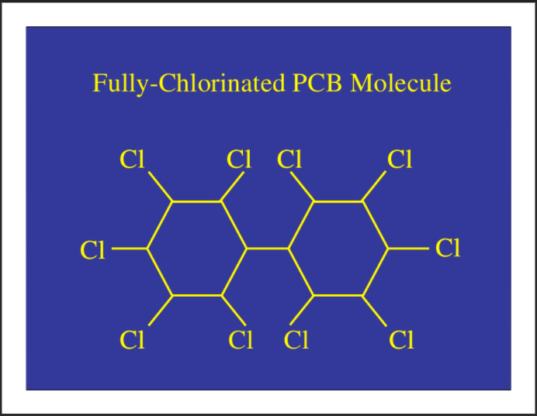
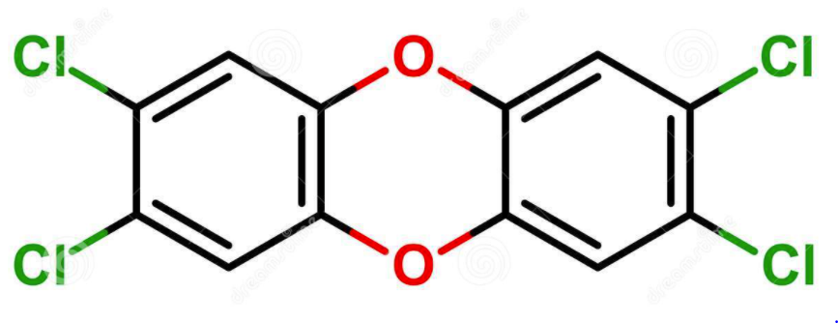
Chemicals Already regulated as a Class
Dioxins
PCBs
TCDD+DL-Dioxins, Furans, PCBs
Common Mechanism (Ah Receptor)
Multiple Mechanisms
  AhR, PXR/SXR, CAR, etc.

Slide 7
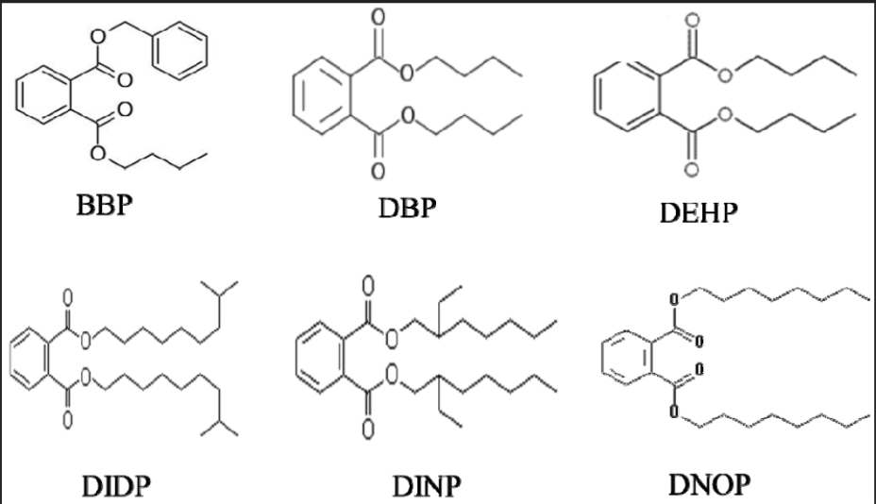
Chemicals Already regulated as a Class (cont.)
PM2.5 Air Pollution
Phthalates
Metals
PAHs
Sulfates
Nitrates
Regulated by Mass
Plasticizers
Several Modes of Action

Slide 8
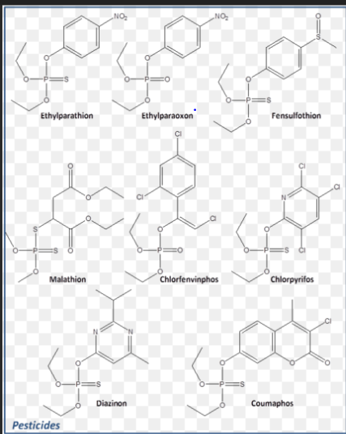
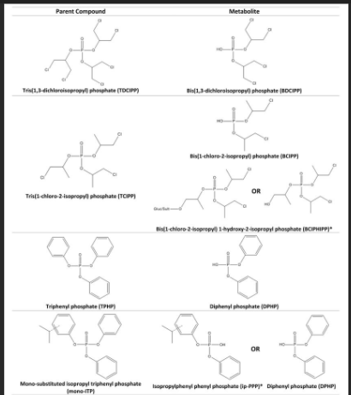
Opportunities to Regulate Chemicals as a Class:
Organophosphate Esters
Anticholinesterase and Developmentally Neurotoxic
OP Pesticides
OP Flame Retardants
OP Plasticizers

Slide 9
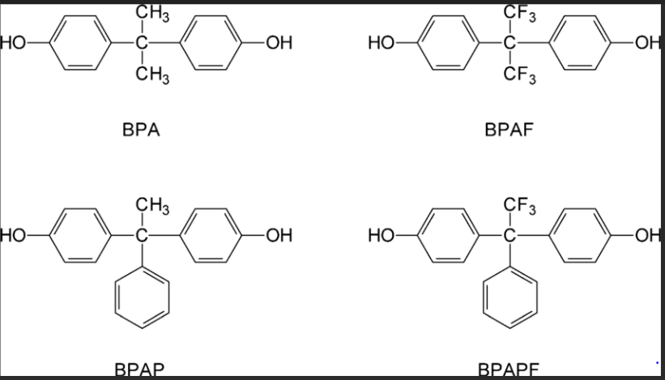
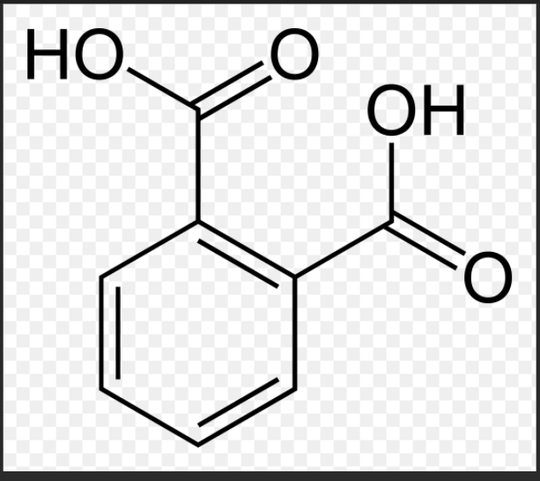
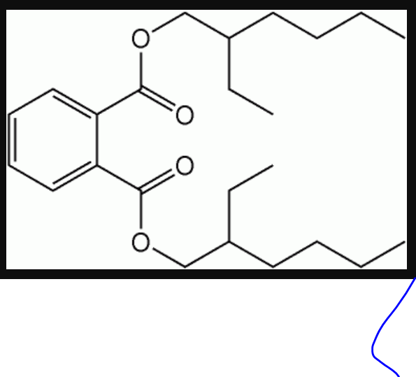
Opportunities to Regulate Chemicals as a Class (cont.)
Bisphenols (“Unfortunate Substitution”)
Low vs. High Molecular Weight Phthalates
Personal care products vs. Plasticizers
PFAS…

Slide 10
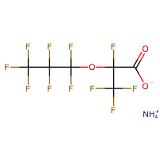
What are Per- and Polyfluoroalkyl Substances (PFAS)?
Total number of PFAS
>9,000 chemicals
  Includes products, impurities and degradants
    Teflon
    Scotchguard
    Aqueous Film Forming Foams (AFFFs)
  Many unknown formulation
Resistant to grease, water & oil
  Surfactants, stain repellants
  Fire suppression - AFFF
Persistent and bioaccumulative
Emergence of short-chain alternatives - less well studied
PFOS
PFOA
PFMOAA
GenX
Notes:
PFOA (C8) used in Teflon
PFOS (C8) in Scotchgard and Gore-Tex
Aqueous fire fighting foam (AFFF) containing PFASs now showing up widely
military installations
Airports
Firefighter training sites

Slide 11
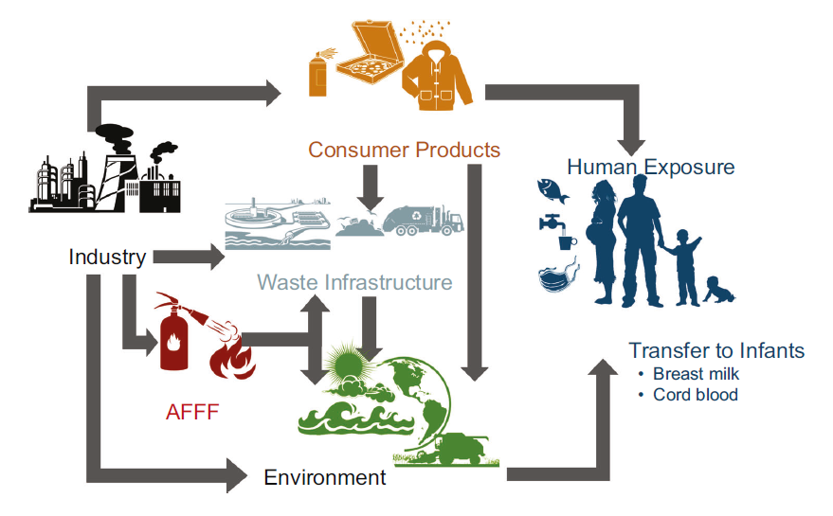
PFAS Exposure
Sunderland et al., J Expos Sci & Epidemiol, 2019
Notes:
With exposures occurring throughout the western human lifestyle, the exposome is also a “System” and must be addressed as such. Breaking one or even a dozen single pathways may reduce but not eliminate exposures.
Acknowledge Elsie Sunderland (Harvard) for this figure (in the audience)
You can use this as a lead in to encourage addressing PFAS as a class such as is underway with CPSC (Consumer Product Safety Commission).
*********
PFAS routes of exposure:
The previous slides highlighted drinking water as a major source of PFAS exposure. And while many of us are familiar with this route of exposure, newer research suggests that air emissions may be one way PFAS reaches our drinking water. PFAS emitted into the air falls back to earth in rainwater, which may be how these chemicals are carried to groundwater miles from the source. In a study conducted by the North Carolina Department of Environmental Quality’s Division of Air Quality, relatively high levels of PFAS were found in rainwater samples up to 20 miles away a chemical plant know to be source of contamination (Chemours - GenX)
But PFAS is in more than our drinking water. We’re also exposed through consumer products such as food contact materials, stain and water-repellent fabrics, nonstick pans, and more.
Image from: Sunderland EM, Hu XC, Dassuncao C, Tokranov AK, Wagner CC, Allen JG. 2019. A review of the pathways of human exposure to poly- and perfluoroalkyl substances (PFAS) and present understanding of health effects. J Expos Sci & Environ Epidemiol 29:131-147.
Affiliation: Department of Environmental Health, Harvard T.H. Chan School of Public Health, Boston, MA, USA.
ABSTRACT: Here, we review present understanding of sources and trends in human exposure to poly- and perfluoroalkyl substances (PFASs) and epidemiologic evidence for impacts on cancer, immune function, metabolic outcomes, and neurodevelopment. More than 4000 PFASs have been manufactured by humans and hundreds have been detected in environmental samples. Direct exposures due to use in products can be quickly phased out by shifts in chemical production but exposures driven by PFAS accumulation in the ocean and marine food chains and contamination of groundwater persist over long timescales. Serum concentrations of legacy PFASs in humans are declining globally but total exposures to newer PFASs and precursor compounds have not been well characterized. Human exposures to legacy PFASs from seafood and drinking water are stable or increasing in many regions, suggesting observed declines reflect phase-outs in legacy PFAS use in consumer products. Many regions globally are continuing to discover PFAS contaminated sites from aqueous film forming foam (AFFF) use, particularly next to airports and military bases. Exposures from food packaging and indoor environments are uncertain due to a rapidly changing chemical landscape where legacy PFASs have been replaced by diverse precursors and custom molecules that are difficult to detect. Multiple studies find significant associations between PFAS exposure and adverse immune outcomes in children. Dyslipidemia is the strongest metabolic outcome associated with PFAS exposure. Evidence for cancer is limited to manufacturing locations with extremely high exposures and insufficient data are available to characterize impacts of PFAS exposures on neurodevelopment. Preliminary evidence suggests significant health effects associated with exposures to emerging PFASs. Lessons learned from legacy PFASs indicate that limited data should not be used as a justification to delay risk mitigation actions for replacement PFASs.

Slide 12

How are we exposed?
[Glϋge et al., Environ Sci: Processes&Impacts, 2020]
Diverse group of chemical compounds used in industry and consumer products worldwide since 1950s
Contaminant in Drinking water
Found in various products:
  Carpet and fabric
  Food paper
  Pots and Pans
  Clothing
  Cardboard packaging
  Firefighting foams (AFFF)
Ingestion (Drinking Water, Food, Dust), Inhalation, Dermal

Slide 13
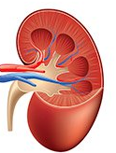

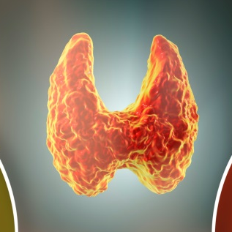






PFAS: Multi-System Toxicants
Kidney
Thyroid
Cancer
Immune
Reproductive
Organs
Liver
Neuro-development
Pancreas
Modified from ATSDR, 2018
Notes:
We’re learning that PFAS have important toxicological effects on many physiological systems. We’ll discuss these effects in depth through this course of the week with plans for plenary sessions and small breakout groups. Encourage the audience to address the multitude of effects from a Systems Perspective.
A major problem we are having addressing PFAS is the tendency for the research community to focus on their favorite effect without considering its role in the pathophysiological system.
Agency for Toxic Substances and Disease Registry (ATSDR). 2018. Toxicological profile for Perfluoroalkyls. (Draft for Public Comment). Atlanta, GA: U.S. Department of Health and Human Services, Public Health Service. https://www.atsdr.cdc.gov/toxprofiles/tp.asp?id=1117&tid=237
*******
Slide to provide high-level summary/overview of PFAS health effects for outcomes where we have sufficient evidence.
PFAS affect multiple tissues in both males and females and at all life stages:
Thyroid, Liver, Pancreas: Laboratory animals exposed to one or more of these PFAS have shown changes in liver, thyroid, and pancreatic function.
Thyroid: Some PFAS alter thyroid hormone homeostasis that regulates metabolism and growth – (may manifest differently in humans vs rodents; TSH humans, T4 rodents)
Pancreas & Liver: Interferes with metabolism; for example, PFAS exposure may contribute to altered insulin resistance and glucose tolerance, overweight, steatosis, altered lipid homeostasis
Immune system: reduced immune function (suppressed antibody response)
Kidneys: altered glomerular filtration rates, chronic kidney disease, cancer
Reproductive Organs: Associated with decreased fertility, gestational hypertension, decreased breastfeeding ability or duration, and testicular cancer
Neurodevelopment: Affects learning and behavior of infants and older children
Many of associations seen in humans are supported by animal testing, in vivo, in vitro models, and structural activity relationships.
Take-home message: These chemicals are biologically active and adversely affecting human health. And many of the health effects seen in humans are supported by animal, in vivo, and in vitro models.

Slide 14
Key Research Questions
Total organic fluorine analysis – Are we measuring 90% or 10% of PFAS present in a sample?
Essentiality – Where are chemicals really needed and where can we replace with safer alternatives? (Cousins et al., 2019)
Assessing alternatives – Are our substitutes safer?
PFAS as a class – One chemical group or subclasses? Too many PFAS to do proper toxicity testing (including mixtures)
  The National Academy of Sciences, Engineering, and Medicine (NASEM) recently addressed hazards to Organo-Halogen Flame retardants in a report to the Consumer Product Safety Commission (CPSC – 7/24/2019).
    NASEM strongly endorsed the use of subclasses of organohalogens in hazard assessment along with the use of alternative toxicological approaches.
  Regulate PFAS as A Class ((Kwiatkowski et al., ES&T Lett. 2020)
  Regulate PFAS as Subclasses (Cousins et al., Env. Sci, Processes&Impacts, 2020)
Notes:
Here are some challenges to the audience…….
Solve
The Essentiality scheme, which is described in a paper published in Environmental Science: Processes & Impacts in , assigns substances to one of three categories:
category 1 non-essential, the substance fulfils functions that might be considered ‘nice to have’;
category 2 substitutable, it fulfils important functions but viable alternatives exist; and
category 3 essential.
For example, their use in cosmetics could be category 1 and their use in membranes necessary for high-tech processes could be category 3.
Reference: Cousins et al. The concept of essential use for determining when uses of PFASs can be phased out, Environmental Science: Processes & Impacts: May 2019.
Affiliation: Department of Environmental Science and Analytical Chemistry (ACES), Stockholm University, SE-10691, Sweden
DOI:10.1039/C9EM00163H
https://pubs.rsc.org/en/content/articlehtml/2019/em/c9em00163h?page=search
Because of the extreme persistence of per- and polyfluoroalkyl substances (PFASs) and their associated risks, the Madrid Statement argues for stopping their use where they are deemed not essential or when safer alternatives exist. To determine when uses of PFASs have an essential function in modern society, and when they do not, is not an easy task. Here, we: (1) develop the concept of “essential use” based on an existing approach described in the Montreal Protocol, (2) apply the concept to various uses of PFASs to determine the feasibility of elimination or substitution of PFASs in each use category, and (3) outline the challenges for phasing out uses of PFASs in society. In brief, we developed three distinct categories to describe the different levels of essentiality of individual uses. A phase-out of many uses of PFASs can be implemented because they are not necessary for the betterment of society in terms of health and safety, or because functional alternatives are currently available that can be substituted into these products or applications. Some specific uses of PFASs would be considered essential because they provide for vital functions and are currently without established alternatives. However, this essentiality should not be considered as permanent; rather, constant efforts are needed to search for alternatives. We provide a description of several ongoing uses of PFASs and discuss whether these uses are essential or non-essential according to the three essentiality categories. It is not possible to describe each use case of PFASs in detail in this single article. For follow-up work, we suggest further refining the assessment of the use cases of PFASs covered here, where necessary, and expanding the application of this concept to all other uses of PFASs. The concept of essential use can also be applied in the management of other chemicals, or groups of chemicals, of concern.

Slide 15
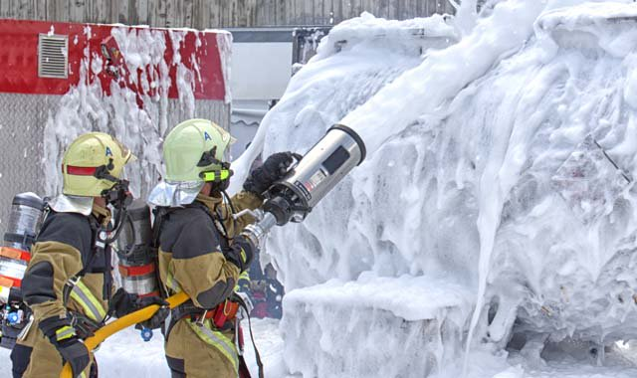

THANK YOU!!!

