Slide 1

The health of Black women
IS your concern.
By Hannah McCall, Clean Beauty for Black Girls

Slide 2

Let’s go on a toxic exposing journey
Iris wakes up & the first thing she does is brush her teeth. In doing so, she potentially exposes herself to fluoride, triclosan, saccharin, carrageenan, and aspartame
The she gets in the shower, where she washes her hair & body. That includes shampoo & conditioner and body wash & exposes her to sulfates, parabens, fragrance, triclosan, polyethylene, and diethanolamine.
Next she starts her face washing routine before putting on makeup. This process introduces sulfates, parabens, phthalates, synthetic colors, fragrance, triclosan, toluene, talk, lead, formaldehyde, sls/sles, and BHT to her body.
Before leaving the house, Iris makes breakfast. Depending on the storage containers she uses, where her food is coming from and what type of pans she uses to cook, she could be additionally exposes to benzene, BPA, chlorine, dioxins, phthalates, PTFE, polyethylene terephthalate, and BFRS

Slide 3

Don’t forget regular household chores & the exposures that come with...
When Iris grabs her cleaning products to clean the kitchen and bathroom she is risking inhalation and skin exposures to chemicals such as phthalate, PERC, triclosan, 2-butoxyethanol, ammonia, chlorine, and sodium hydroxide
Over her lunch break she throw in a load of laundry and adds SLS/SLES, phosphates, formaldehyde, VOCs, chlorine bleach, dioxine, fragrance, and benzyl acetate to the plate
Before sitting down for the day, Iris takes out the garbage and is met with lead, arsenic, petroleum products, and PCBs
Finally she sits down to relax and catch up on tv, only to meet her couch & flame retardants

Slide 4
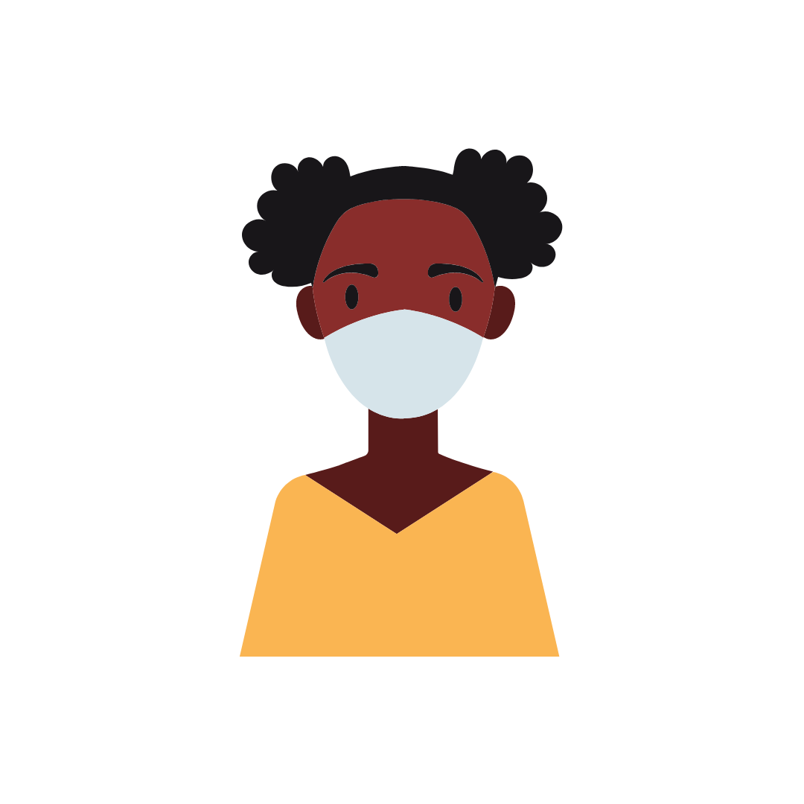
So why highlight Black women & Communities of color if everyone is exposed?
Black women have higher levels of beauty related chemicals in our bodies
Black women have higher rates of hormone-related conditions
Hear this: 75% of personal care products marketing to Black women were found to be potentially harmful to their health (per the EWG). Compared to 40% for the remaining population
Black women use more products than their peers of other ethnicities

Slide 5


Of the over 80,ooo chemicals on the market, only 14 have been properly studied and banned
Women, on average, use 20 products a day - that’s easily 36 chemicals that are absorbed by the skin and/or inhaled.
70 to 90% of chronic disease is due to environmental exposures
A large culprit being endocrine disruptors
  Black women are 2-3x more likely to develop aggressive breast cancer
    40% of Black women with an abnormal BRCA gene (increases breast cancer risk) had no close relatives with breast cancer
  Black women have a risk of developing fibroids at rate 3x that of white women
This is more
than a
coincidence.

Slide 6
The placement of manufacturing & waste facilities is racist
Low-income communities are targeted with plastic packaging & single-use plastic products
More than 50% of the people who live within 2 miles of a toxic waste facility are people of color
Black people are 75% more likely to live in “fence line” with a petrochemical facility
Not a coincidence that this creating a potent exposure to formaldehyde translates to Black children developing asthma at a rate of 13% - compared to 7% of white children

Slide 7

Why is it you don’t care?
Why is it you feel no urgency to improve & implement changes?
My question is -
why is this not enough to make a change now?
You need to ask yourself. Are you a part of the problem?
Is your company a part of the problem?

Slide 8

Transparency.
A step forward - because with transparency comes accountability. The overall consumer market is slowing becoming one that knows better - on both side of the product. The demand is there to do the right thing & show us how that is so.
Public access to annual reports that show:
  Progress to improving chemical policies
  Publishing of the eliminations made years-to-year
    Includes product ingredients & packaging ingredients
Representation matters.
Look around the room of decision makers at your organization. Who do you see?
Do you see those who are largely impacted? When you don’t, you can be assured your toxicity starts at the top.
Where do we go from here?

Slide 9
The health of Black women
IS your concern.
Find us at cleanbeautyforblackgirls.org & on Instagram @cleanbeautyforblackgirls

