Slide 1

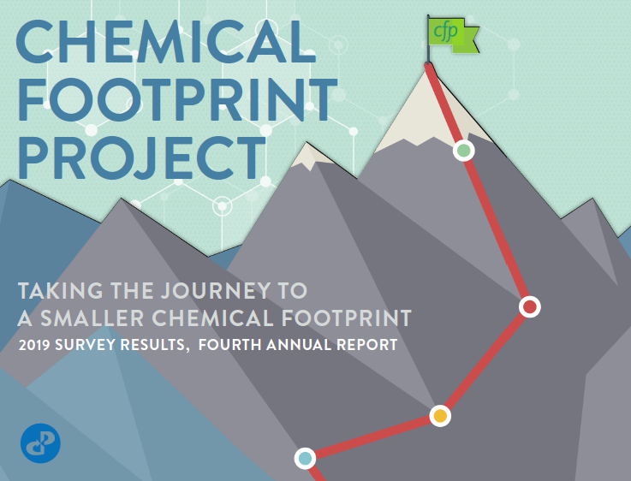
Preview of the 2020 Annual Report
December 8, 2020

Slide 2
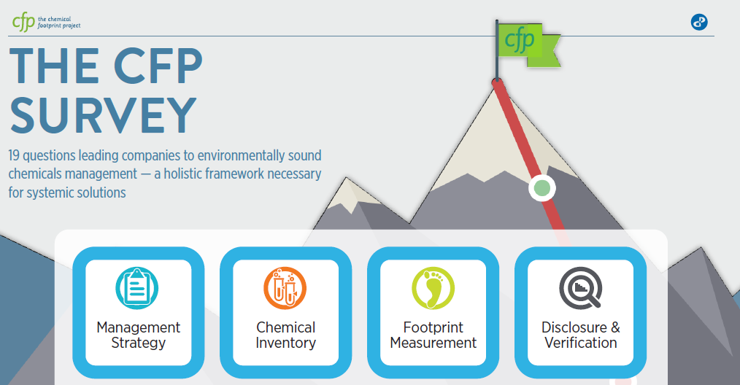

5th
^{annual}

Slide 3

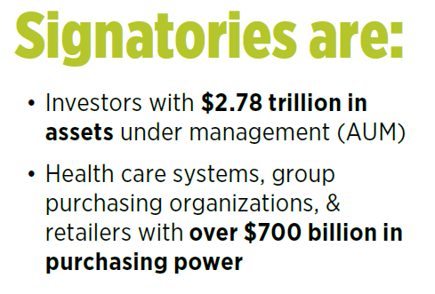
Investors include …
Health Care & Retail include …
CVS Health, Rite Aid, Staples, Target & Walmart
Calvert Research & Management
Bank J Safra Sarasin
BNP Paribas Investment Partners
Boston Common Asset Management
Impax Asset Management
Trillium Asset Management
Legal & General Investment Management
Rhode Island Treasury
The Sustainability Group of Loring, Wolcott & Coolidge
Dignity Health, Kaiser Permanente, & Vizient
Notes:
Over 60 signatories, 44 investors, 13 health care, 3 retailers

Slide 4
Participants in 2020 Survey
33 companies
Sectors:
Apparel / Textiles
Building / Furnishings
Cleaning / Personal Care
Medical devices/supplies
Technology
Retail
Toys
Disclosure:
15 disclosed scores
12 disclosed responses

Slide 5

Participant Scores
Compliance
Best practice
Average score: 56

Slide 6
Average scores, new vs. returning participants
(% of total possible points)

Slide 7
Participant Scores: Frontrunners
Frontrunners
Compliance
Best practice

Slide 8
Frontrunners: Distinguishing characteristics
Senior level accountability (M4)
Chemical footprint calculation (F2, F3)

Slide 9
Frontrunners: Distinguishing characteristics
Preference for safer alternatives (M1, F5)
Likelihood to disclose (I2, F2)

Slide 10
CFP 2020 Annual Report
Will be released December 15, 2020
Available at chemicalfootprint.org
cheri@cleanproduction.org

